Slide 1
U-Qasar Methodology Aalto University, Finland Juha Itkonen Pia Lindqvist SINTEF, Norway Børge Haugset

Slide 2
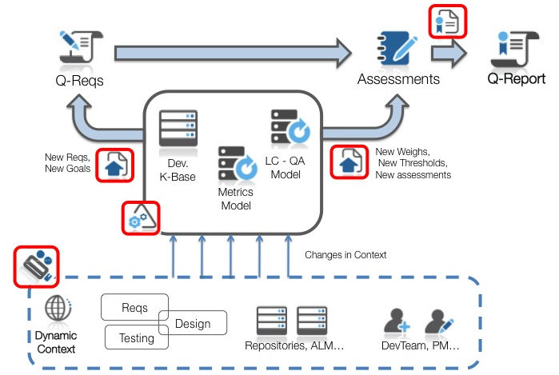
Methodology STRUCTURE
Techniques for analysing the metric data
Techniques
for defining
quality metrics
Techniques for providing feedback on achieved quality to stakeholders
Techniques for identifying quality goals and needs of stakeholders

Slide 3
Overview of the method
Background & Concepts
Adaptation guidelines
Description & Instructions
Workshop techniques
Checklists
Setting Quality Objectives
Designing and implementing the indicators & metrics
Data collection and tracking
Analysing the measurement results
Making improvements
Implementing the Quality Model
Templates
The U-QASAR Platform

Slide 4
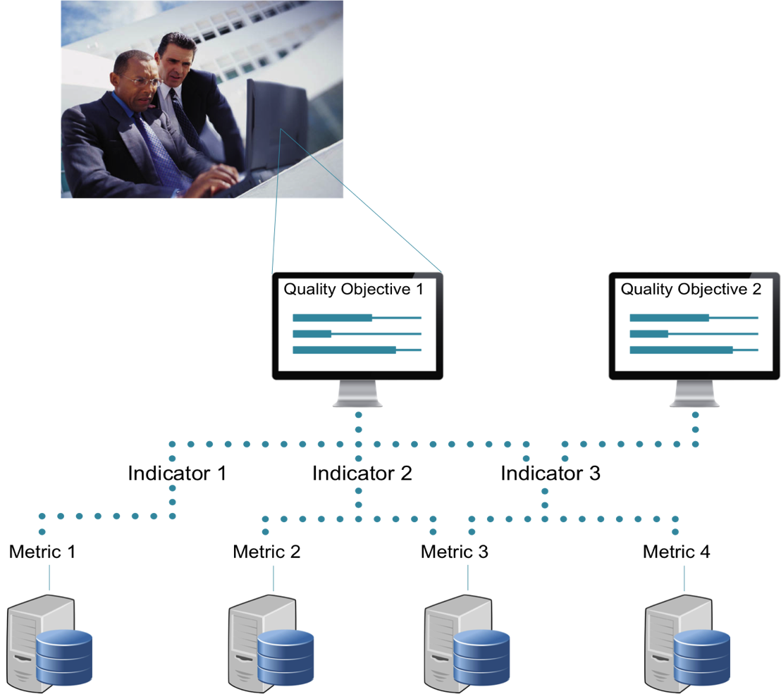
A quality model… what?
“A quality model is a practical definition of quality in a project”
“A quality model includes one or several quality objectives. Quality objectives are described by one or several quality indicators. Quality indicators are measured by quality metrics.”

Slide 5
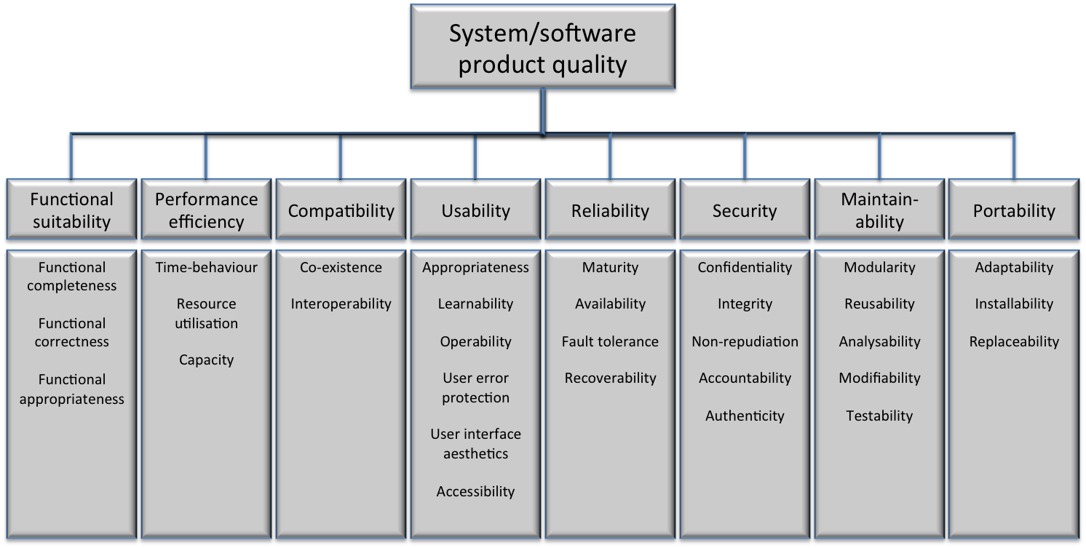
Product Quality objectives
“A quality objective is a high-level viewpoint to a certain characteristic”
By ISO/IEC 25010 Quality model (ISO/IEC 2010)

Slide 6

Process Quality objectives
“A quality objective is a high-level viewpoint to a certain characteristic”
RE process
conformance
Test process
conformance
Standard & policy
conformance
Contract conformance
Schedule
conformance
SW development process conformance

Slide 7
example!
QUALITY MODEL
Quality objective:
Functional correctness
Quality objective:
Reliability
Indicator 1: Defect rate
Indicator 2: Test coverage
Indicator 1: System availability
Metric 1: Fix rate
Metric 2: Amount of open blocker defects
Metric 1: TLOC / LOC
Metric 2: Control structure coverage
Metric 1: Mean time to failure

Slide 8
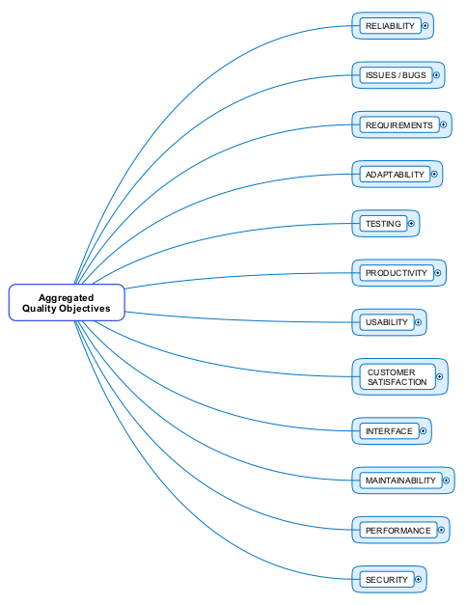
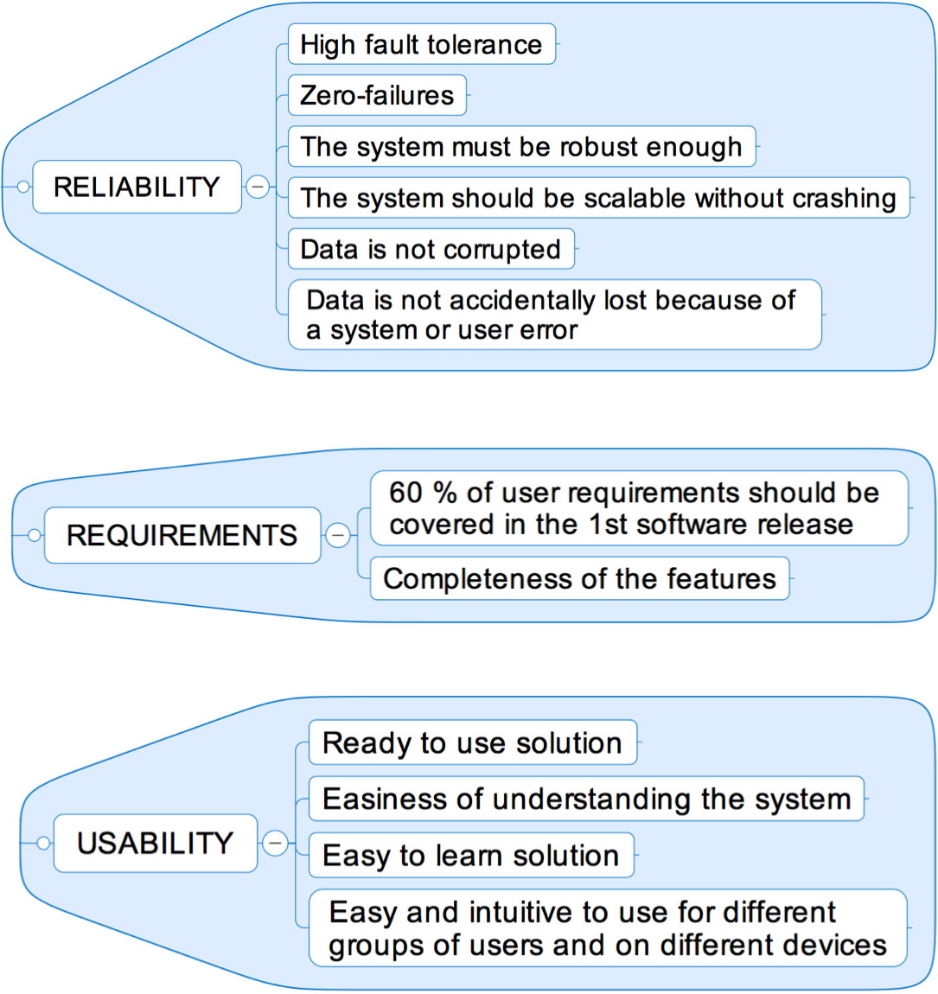
example
Outcome of an early phase test workshop

